Slide 1
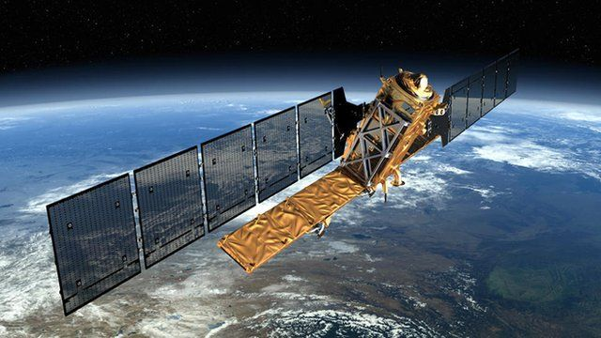
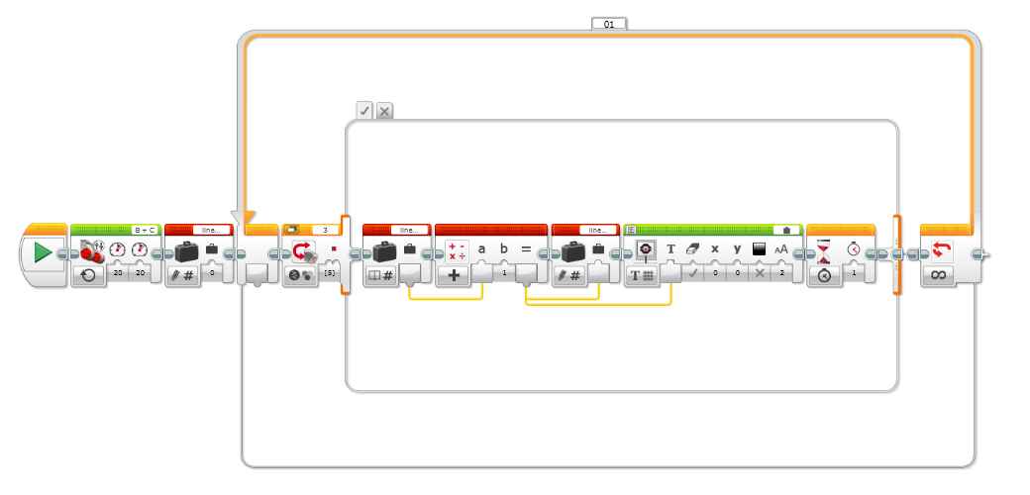
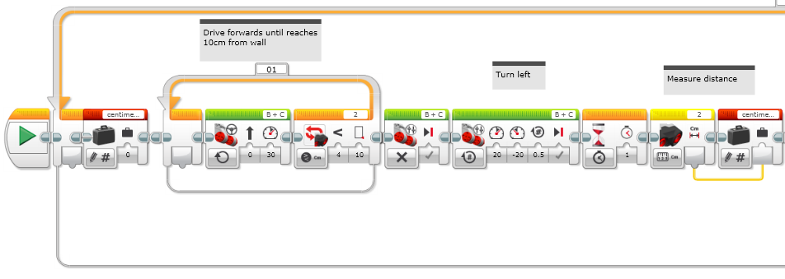
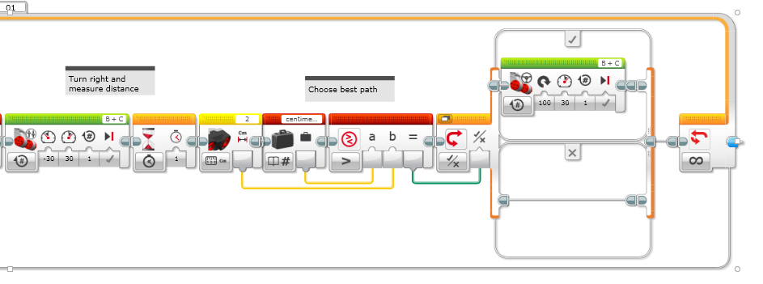
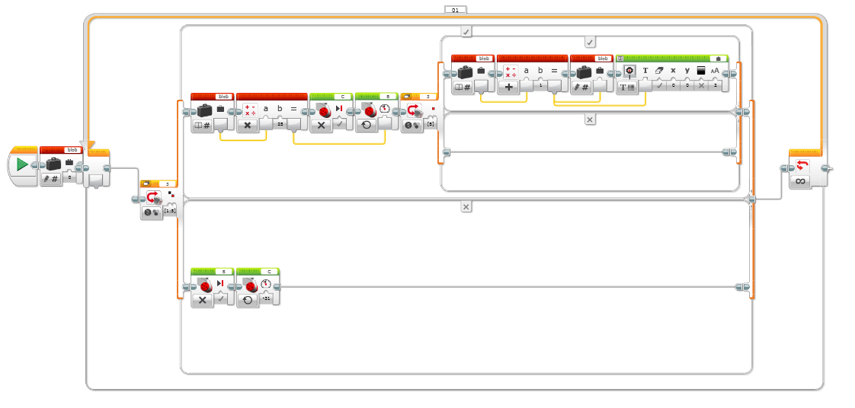
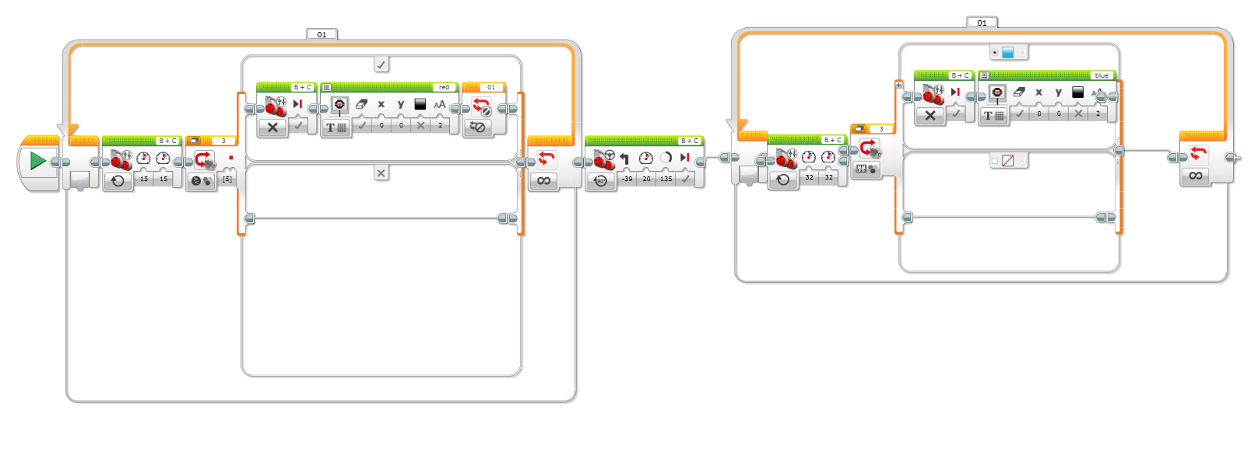
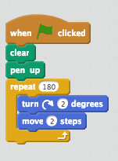
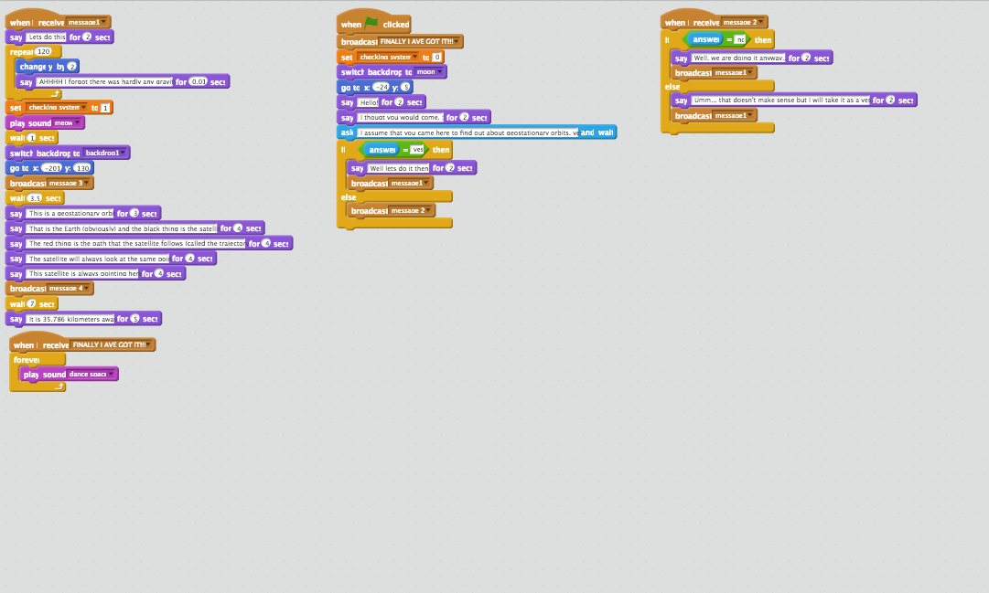
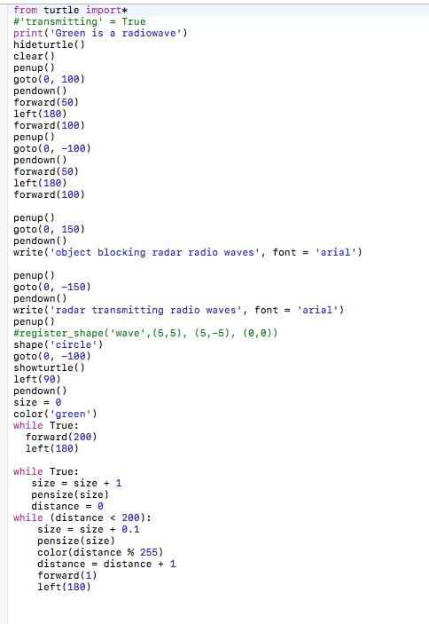
ALL SAINTS robot club
Introduction
In All Saints Robot Club we have done a lot of challenges with programming robots and made a presentation about satellites. First we did some easy challenges and then we split into groups and did more challenging challenges. This poster is about the code behind all our challenges!
c
Line Counting
We had to programme the robot to drive over the red lines and count them as it drove over them.
Maze
We programmed our robot to drive forwards until it sensed an object. Then turn 90 degrees left before turning 180 degrees right, measuring distance with the ultrasonic sensor. The robot would then turn to whichever direction provided the most space and start the whole process all over again!
Synchrotron
We had to programme the robot to go round the circle 3 times, getting 1.5x faster every time it passed a red line.
Coloured Blocks
The robot had to move from 1 coloured block to the other and say the colour.
Scratch
We made Scratch and Python animations about satellites.
Polar Orbit
Geostationary Orbit
Radar Python

